Slide 1
Attacking GraphQL APIs
Mazin Ahmed
OWASP AppSec Days Pacific Northwest 2024
mazin@mazinahmed.net | @mazen160

Slide 2
WHO AM I?
Mazin Ahmed
AppSec Engineering at Chime
Founder of FullHunt
Occasional Bug Bounty Hunter: acknowledged by Facebook, Twitter, LinkedIn, Zoom, and more
In love 💛 with Cloud security, security automation, DevSecOps, distributed systems, and Web-App security

Slide 3
WHO USES GRAPHQL HERE? 🤚

Slide 4






What is GraphQL?
A query language for APIs.
The most popular query definition language for modern apps and tech stacks.
Created by Meta in 2012.
Today, it’s used by:
and a lot more.

Slide 5
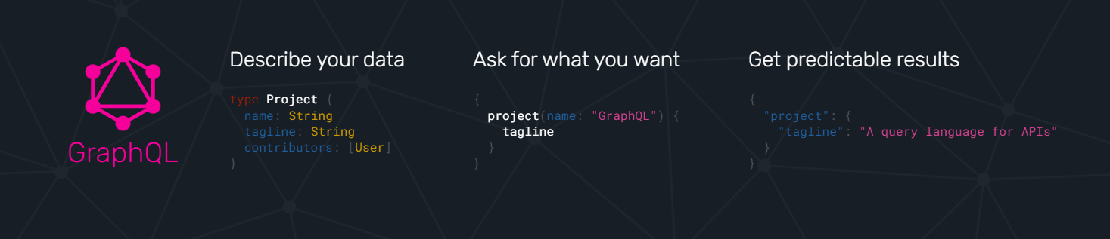
What is GraphQL?
GraphQL offers native flexibility, great API features, and endless possibilities for supporting application development.

Slide 6
“With great power comes great responsibility”

Slide 7
AGENDA
Why am I researching GraphQL security?
GraphQL 101: REST vs GraphQL
GraphQL-focused attack vectors
Exploiting GraphQL APIs
Open-Source Release 🚀
Recommendations – Defending against GraphQL attacks
Questions

Slide 8
GraphQL Jargon 📝
Operation
  GraphQL Query
  GraphQL Mutation
SDL (Schema definition language)
Operation/Query/Mutation Batching
Aliases

Slide 9
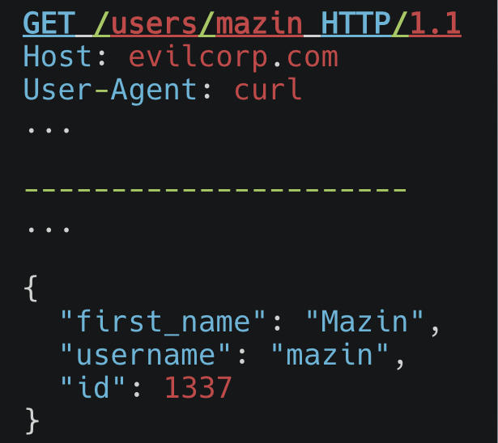
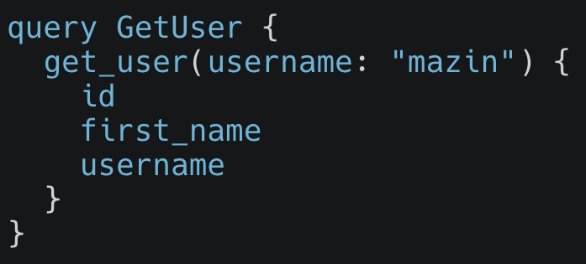
API Comparison: REST vs GraphQL
Querying data in GraphQL vs. REST API
GraphQL Query Operation
REST API GET Request

Slide 10
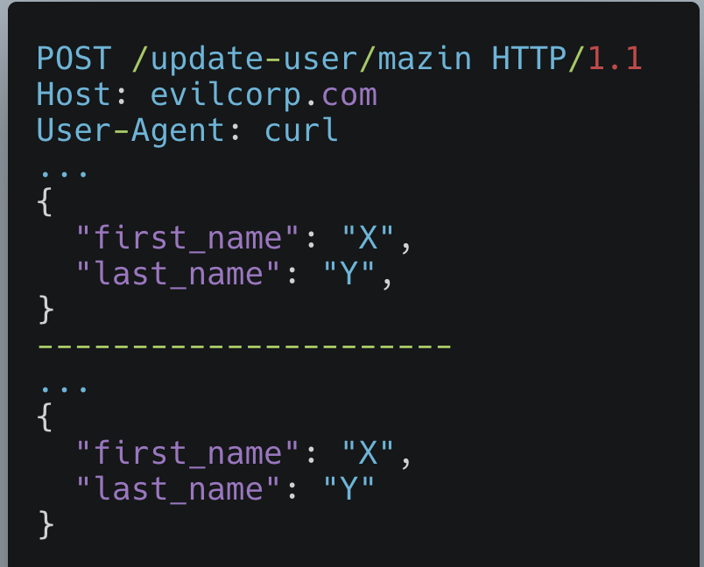
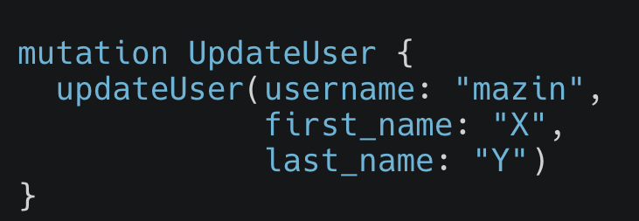
API Comparison: REST vs GraphQL
Updating data in GraphQL vs. REST API
GraphQL Mutation Operation
REST API POST Request

Slide 11
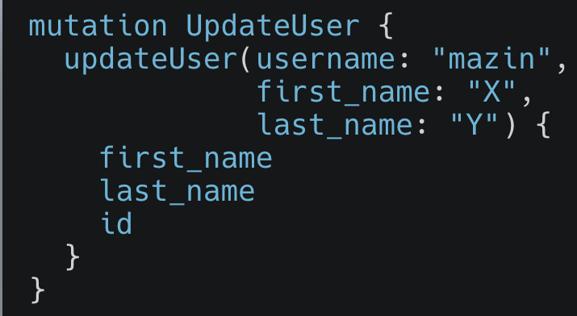
API Comparison: REST vs GraphQL
Updating data in GraphQL vs. REST API
GraphQL Mutation Operation - Asking for fields in response
REST API POST Request

Slide 12
Attacking GraphQL

Slide 13
Attacking GraphQL
How do you feel about your company’s GraphQL Security?

Slide 14
Attacking GraphQL
GraphQL APIs attack surface is massive.
There are several implementations depending on the backend language, framework, and configurations.
Not all configurations are secure-by-default.
There are GraphQL attacks that are harder to remediate with basic configuration changes.

Slide 15
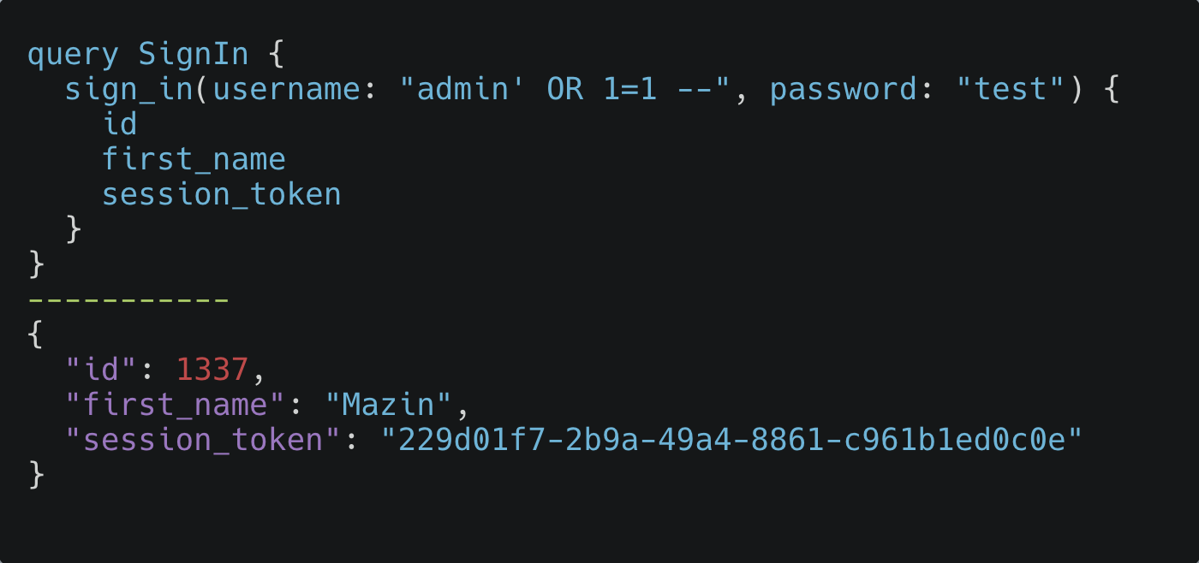
Generic Server-side vulnerabilities
All generic server-side vulnerabilities applies to GraphQL.
For example: SQL Injection, RCE, IDOR Path Traversal, SSRF, File upload issues

Slide 16
Rate Limiting
Lack of rate limiting is a major issue in APIs (SOAP, REST, GraphQL, name your technology).

Slide 17
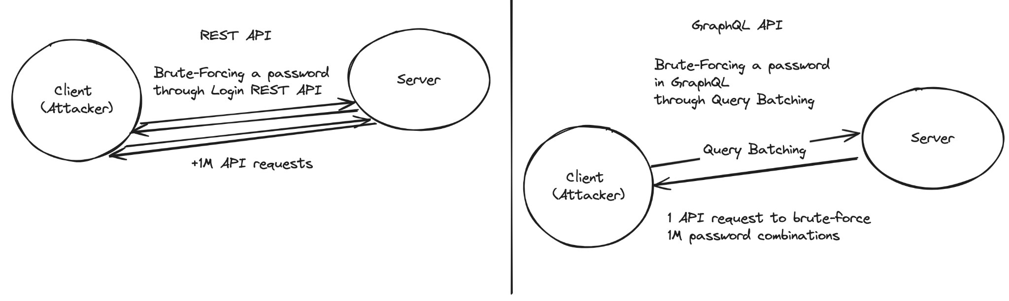
Rate Limiting
Let’s imagine you’re trying to brute-force a password for an admin.

Slide 18
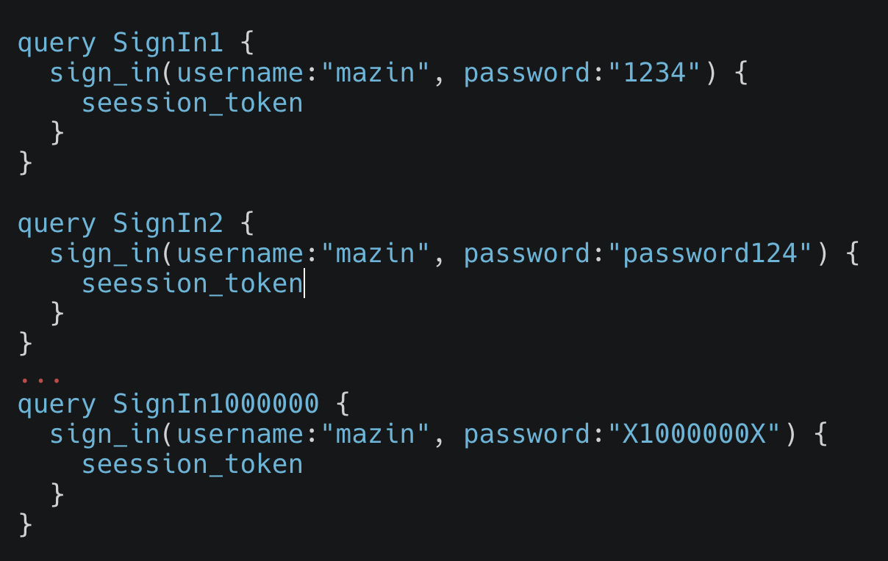
Rate Limiting

Slide 19
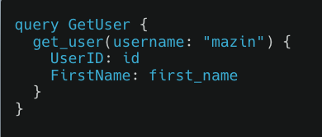
Rate Limiting: Alias Batching
GraphQL Aliases is a feature that simplifies Query management within client/server communication.

Slide 20
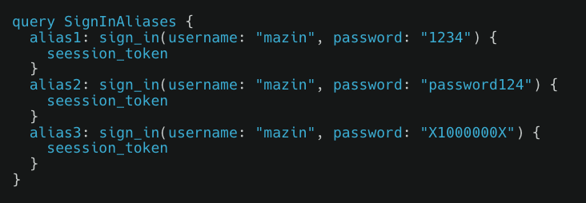
Rate Limiting: Alias Batching
GraphQL Aliases can be exploited to bypass Rate Limiting protection.

Slide 21
GraphQL API Attack Surface Exposure

Slide 22
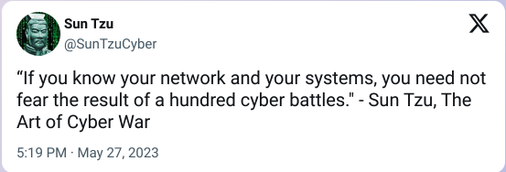
GraphQL API Attack Surface Exposure

Slide 23
GraphQL API Attack Surface Exposure
Documentation is a major challenge for APIs.
There are automated tools to help documentation, eg.. OpenAPI Format, Swagger.
If API documentation is not there, we would need to:
Brute-Force endpoints, parameters, spend hours on fuzzing, yet not having full visibility.
Intercept traffic on web and mobile apps.
OSINT.

Slide 24
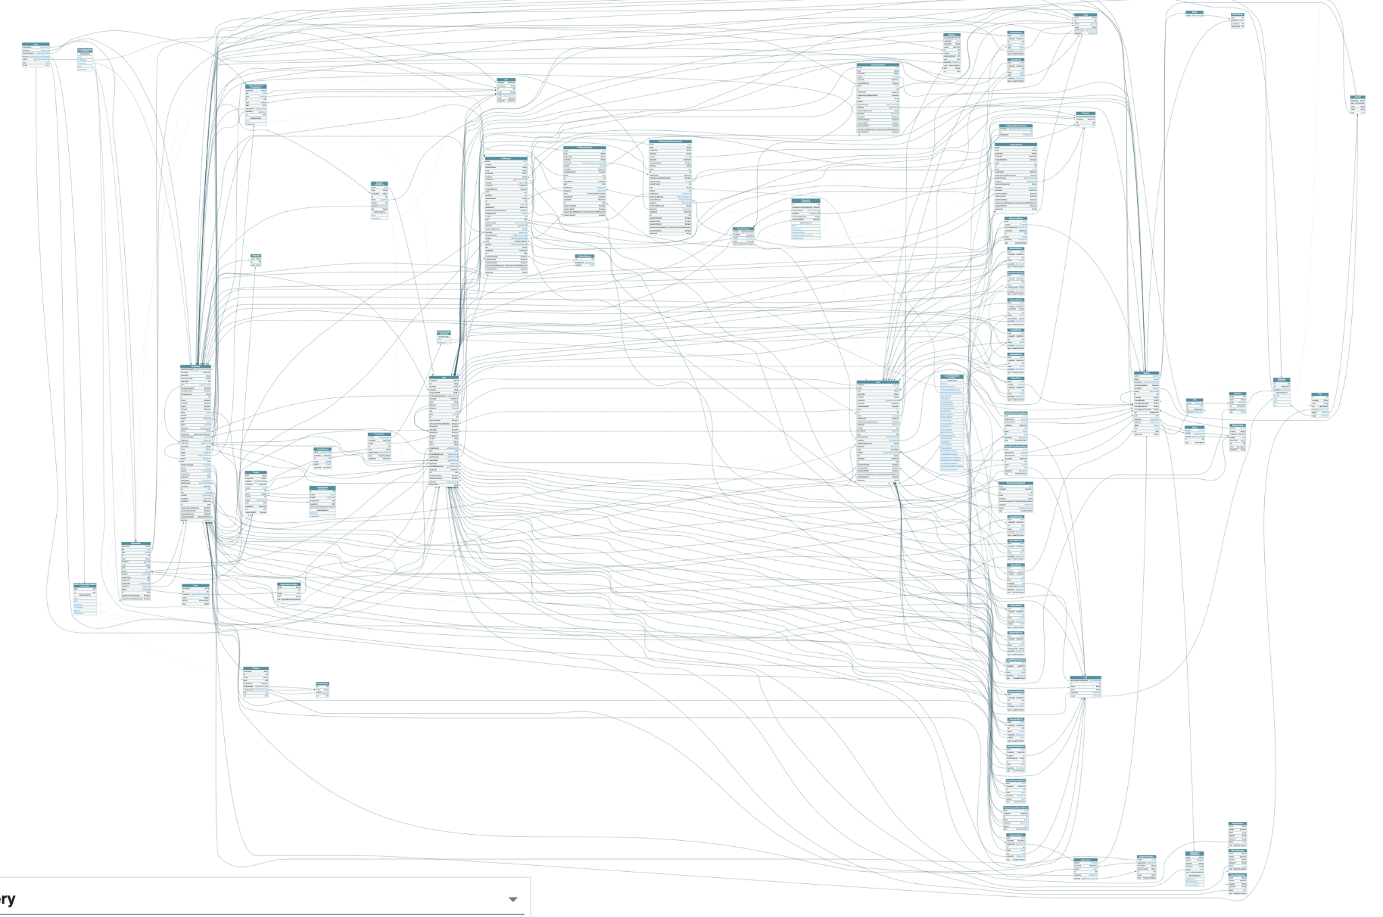
This what Github public GraphQL schema look like

Slide 25
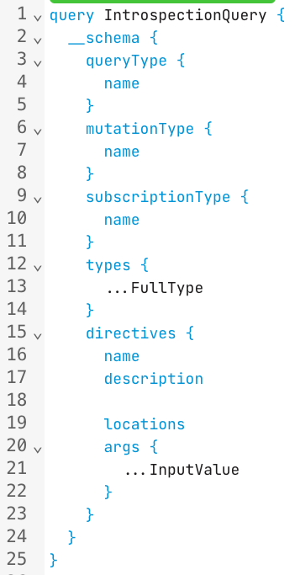
GraphQL Introspection
In GraphQL, a native feature called Introspection that allows you to query the schema.
If an API has Introspection enabled, you can learn about the API schema without spending time on fuzzing.
Introspection is helpful for development and public APIs, but it should be disabled for private GraphQL APIs.

Slide 26
GraphQL Introspection
If GraphQL introspection is disabled on production, it’s a good idea to check if QA/Staging/Dev APIs have it disabled too.
Most likely QA APIs would allow it, and it will expose the full schema.

Slide 27
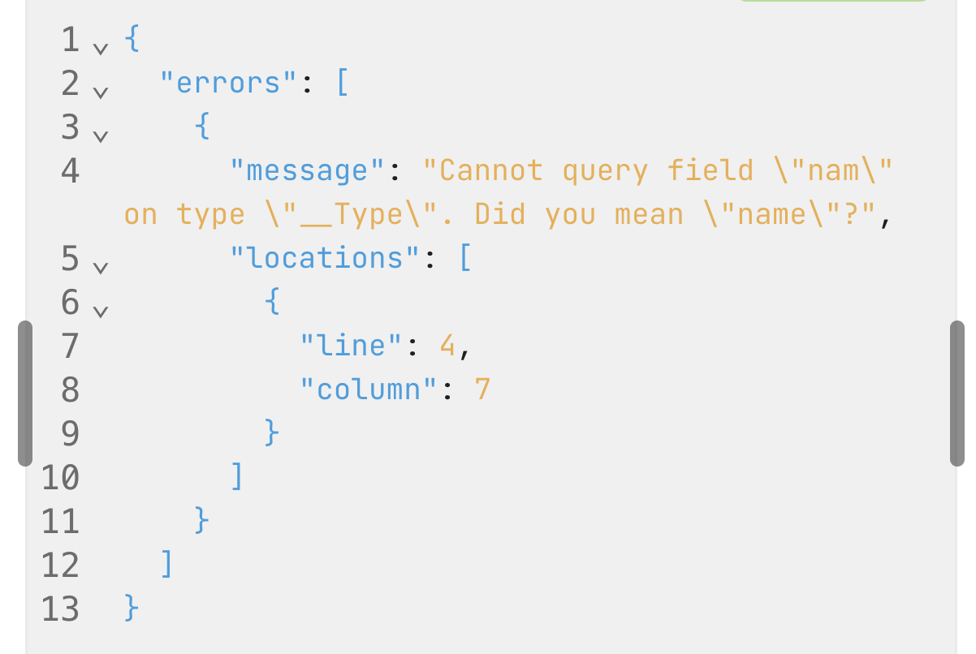
GraphQL Field Guessing
If Introspection is disabled, we can still find ways to enumerate schema and discover with field guessing.
Clairvoyance tool by Nikita Stupin automates GraphQL Field Guessing attack and generates a SDL (Schema Definition Language) file for other GraphQL visualizers.

Slide 28
GraphQL API Exposure Monitoring
By sending Introspection queries on a frequent basis, you can work on compare different results for changes and exposure to identify new and updated GraphQL Queries, Mutations, and Subscriptions.

Slide 29
GraphQL API Exposure Monitoring
Companies may expose unprotected new operations, sensitive input arguments, sensitive PII fields of other users.

Slide 30
GraphQL Denial of Service Attacks

Slide 31
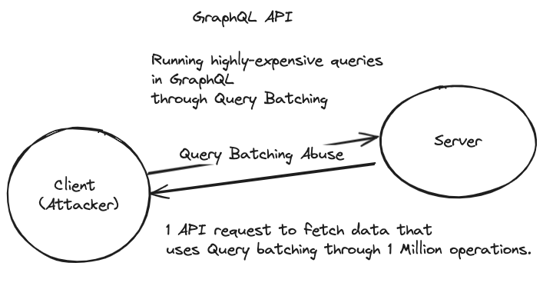
GraphQL Denial of Service Attacks
GraphQL API Denial of Service attacks are trivial and challenging to prevent.
There are several variants of GraphQL DoS attacks today.

Slide 32
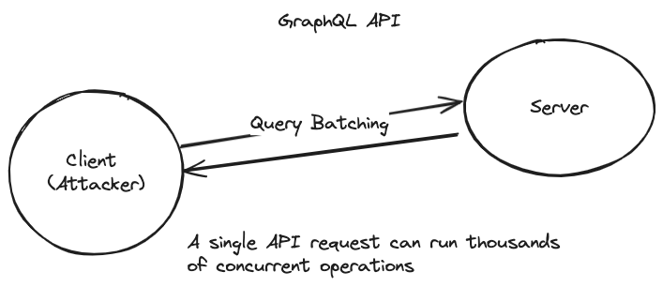
GraphQL Denial of Service Attacks
The approach is to force the GraphQL API to process expensive queries.

Slide 33
GraphQL Denial of Service Attacks
GraphQL Operation Batching variants:
Query/Mutation Batching
Array-Based Batching
Alias Batching

Slide 34
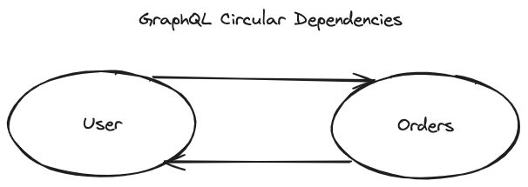

GraphQL Denial of Service Attacks
Circular Relations/Dependency.
Circular Dependency happens when multiple objects are depended on each other.
If User object has a set of Orders.
And the Orders object references the User, then this can be exploited to force GraphQL API to run a complex query.

Slide 35
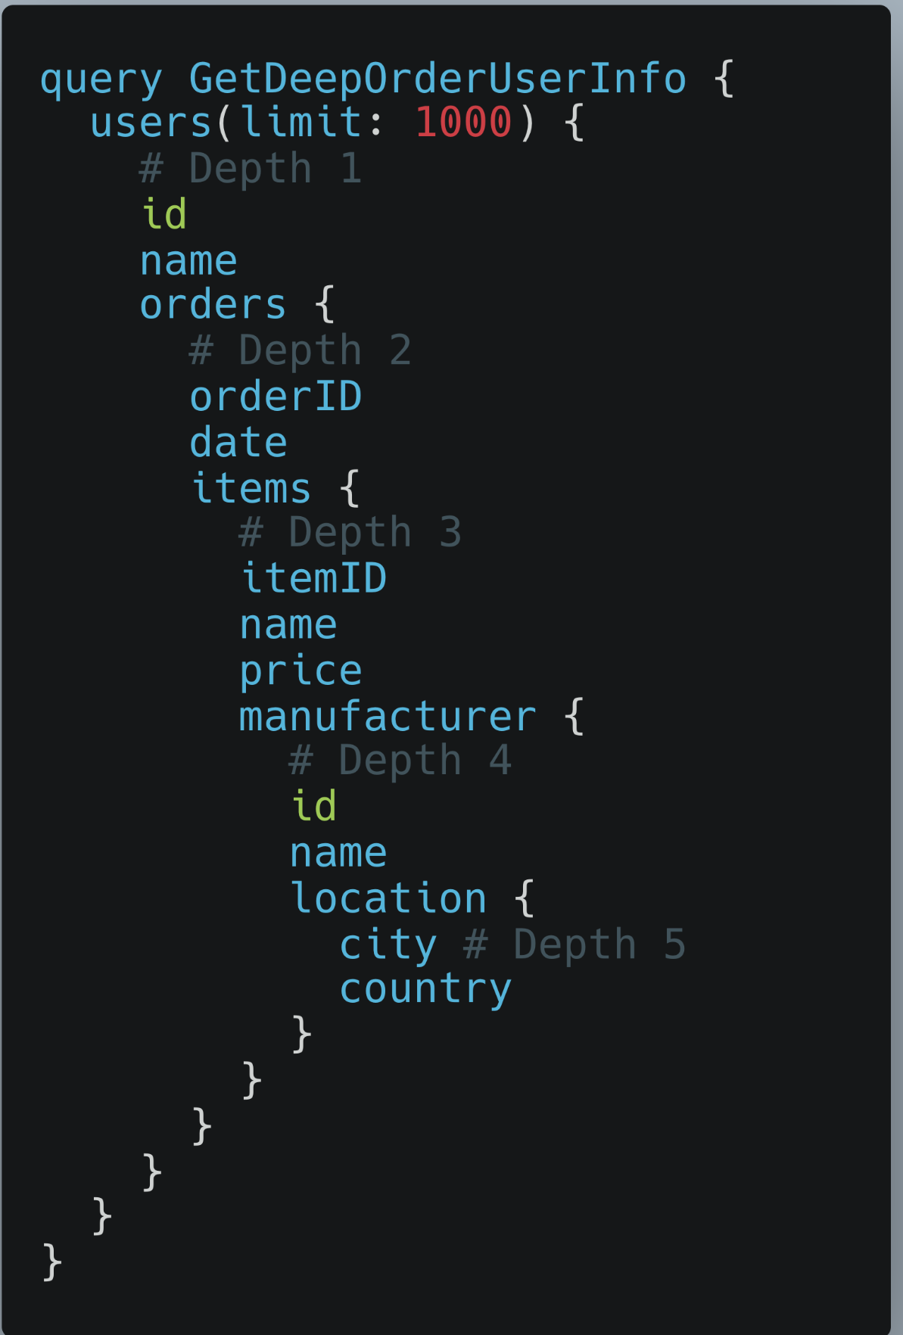
GraphQL Denial of Service Attacks
Constructing expensive queries can lead to a successful DoS attack.
Complex Queries:
🚨This query should send 5,000 API calls internally🚨

Slide 36
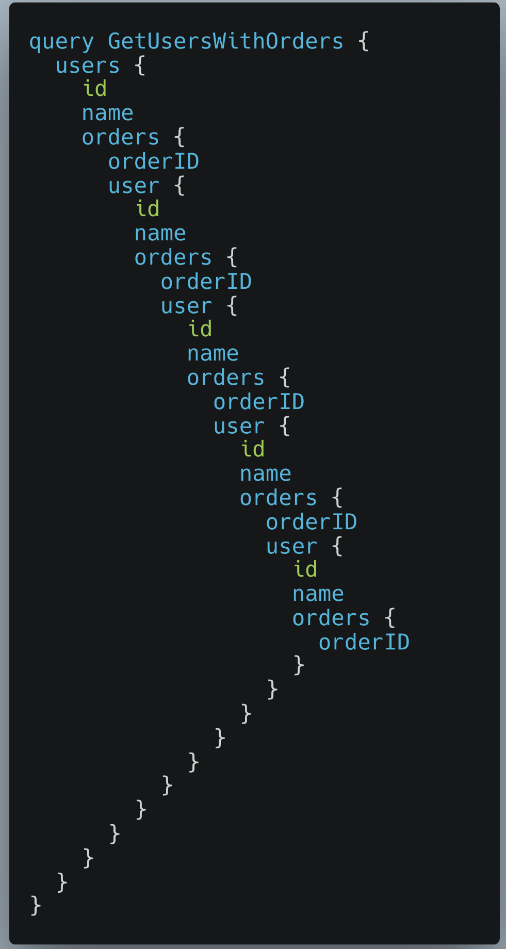
GraphQL Denial of Service Attacks
Circular Relations/Dependency.
This example sends out can be used to reference objects to cause resource exhaustion.
Circular Dependencies is an anti-pattern for non-rate limited APIs.

Slide 37

GraphQL Denial of Service Attacks
There are more DoS attack variants 🙌
Field duplication
Fragments abuse
Directive overloading
User-controlled limits (which happens a lot)
Circular fragments
And more…

Slide 38
{{ Real-World Attacks }}

Slide 39
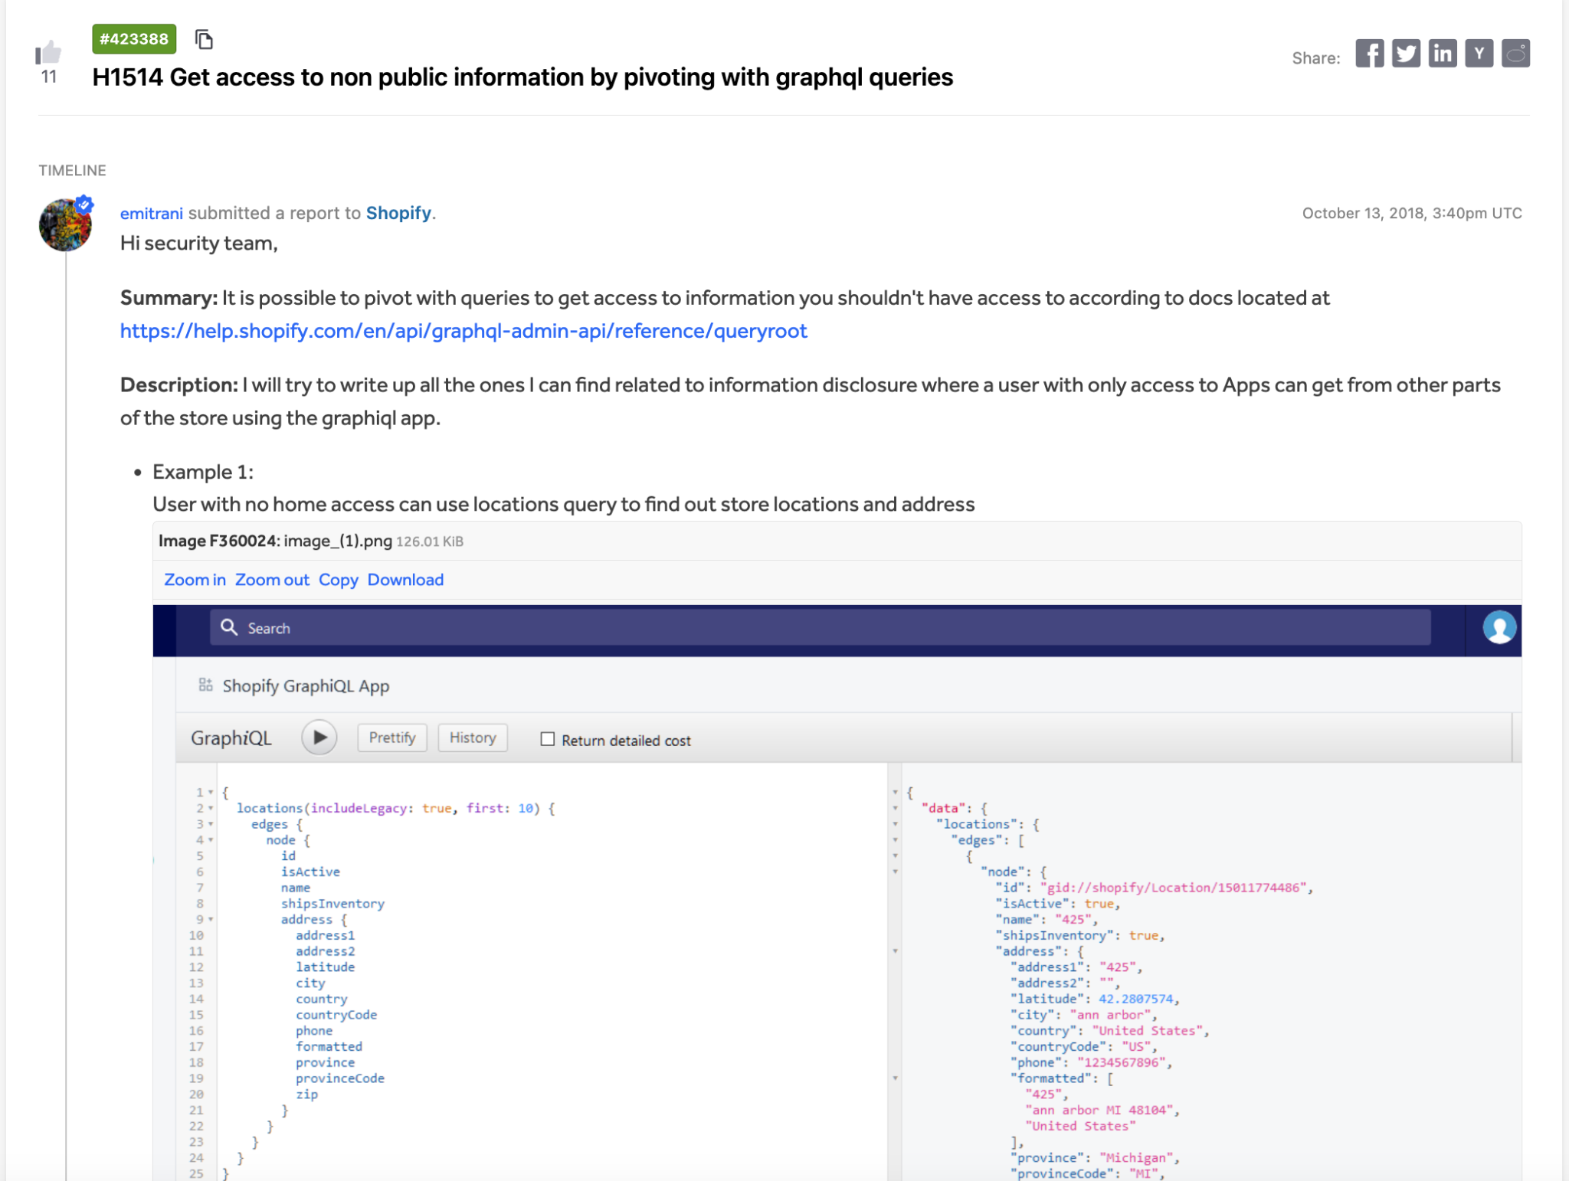
(Shopify) Field Exposure - Led to sensitive customer data leak
Shopify had schema fields that are sensitive and lacked access control checks.

Slide 40
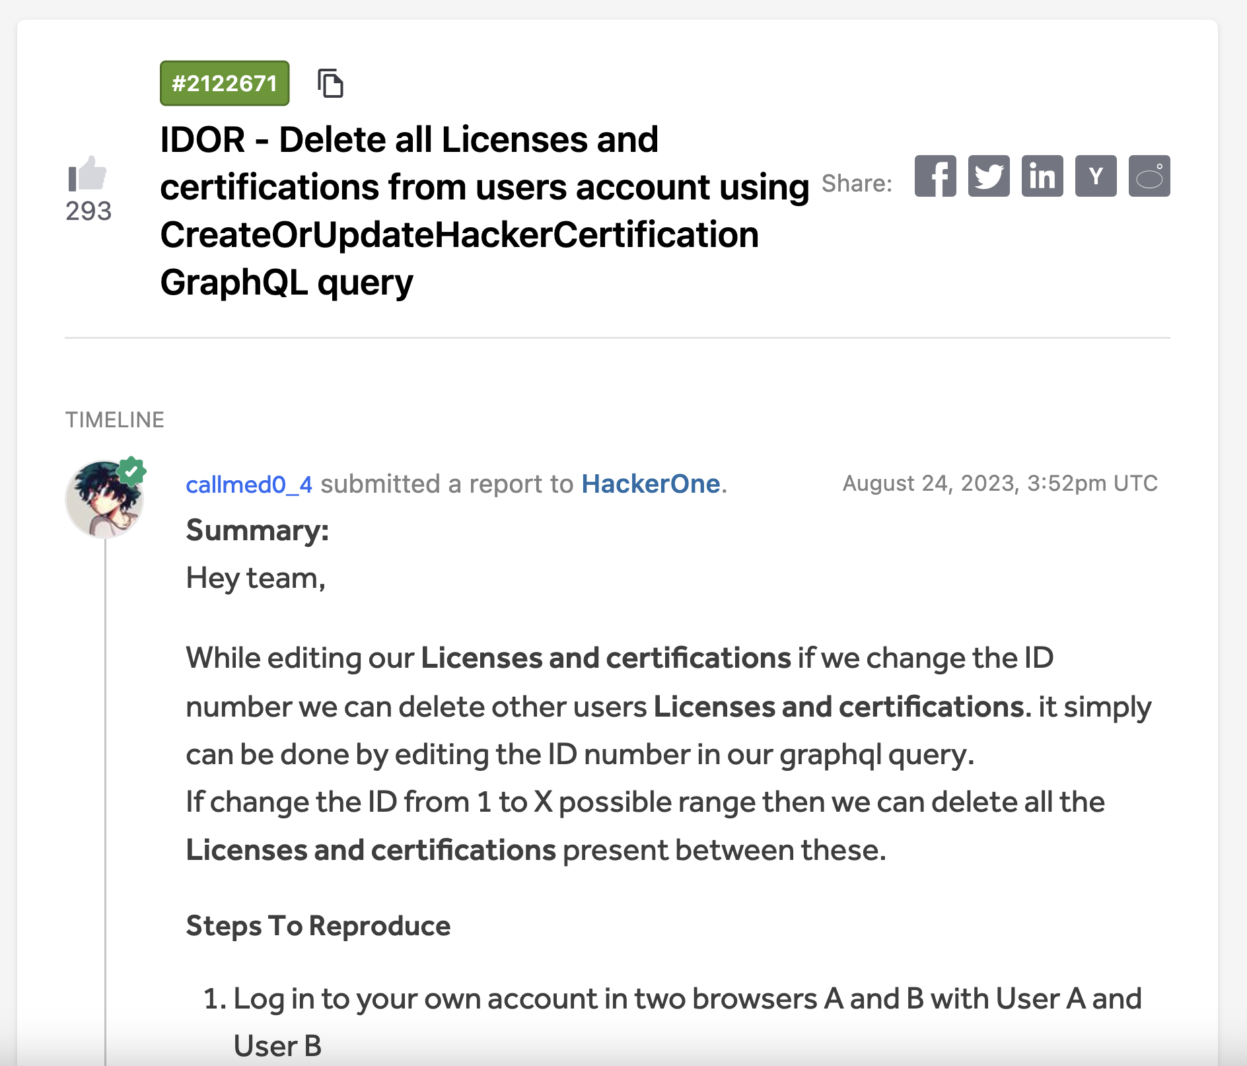
(HackerOne) IDOR - Delete other hackers data
HackerOne had a GraphQL access control vulnerability that allowed hackers to delete data of other hackers in the platform.

Slide 41
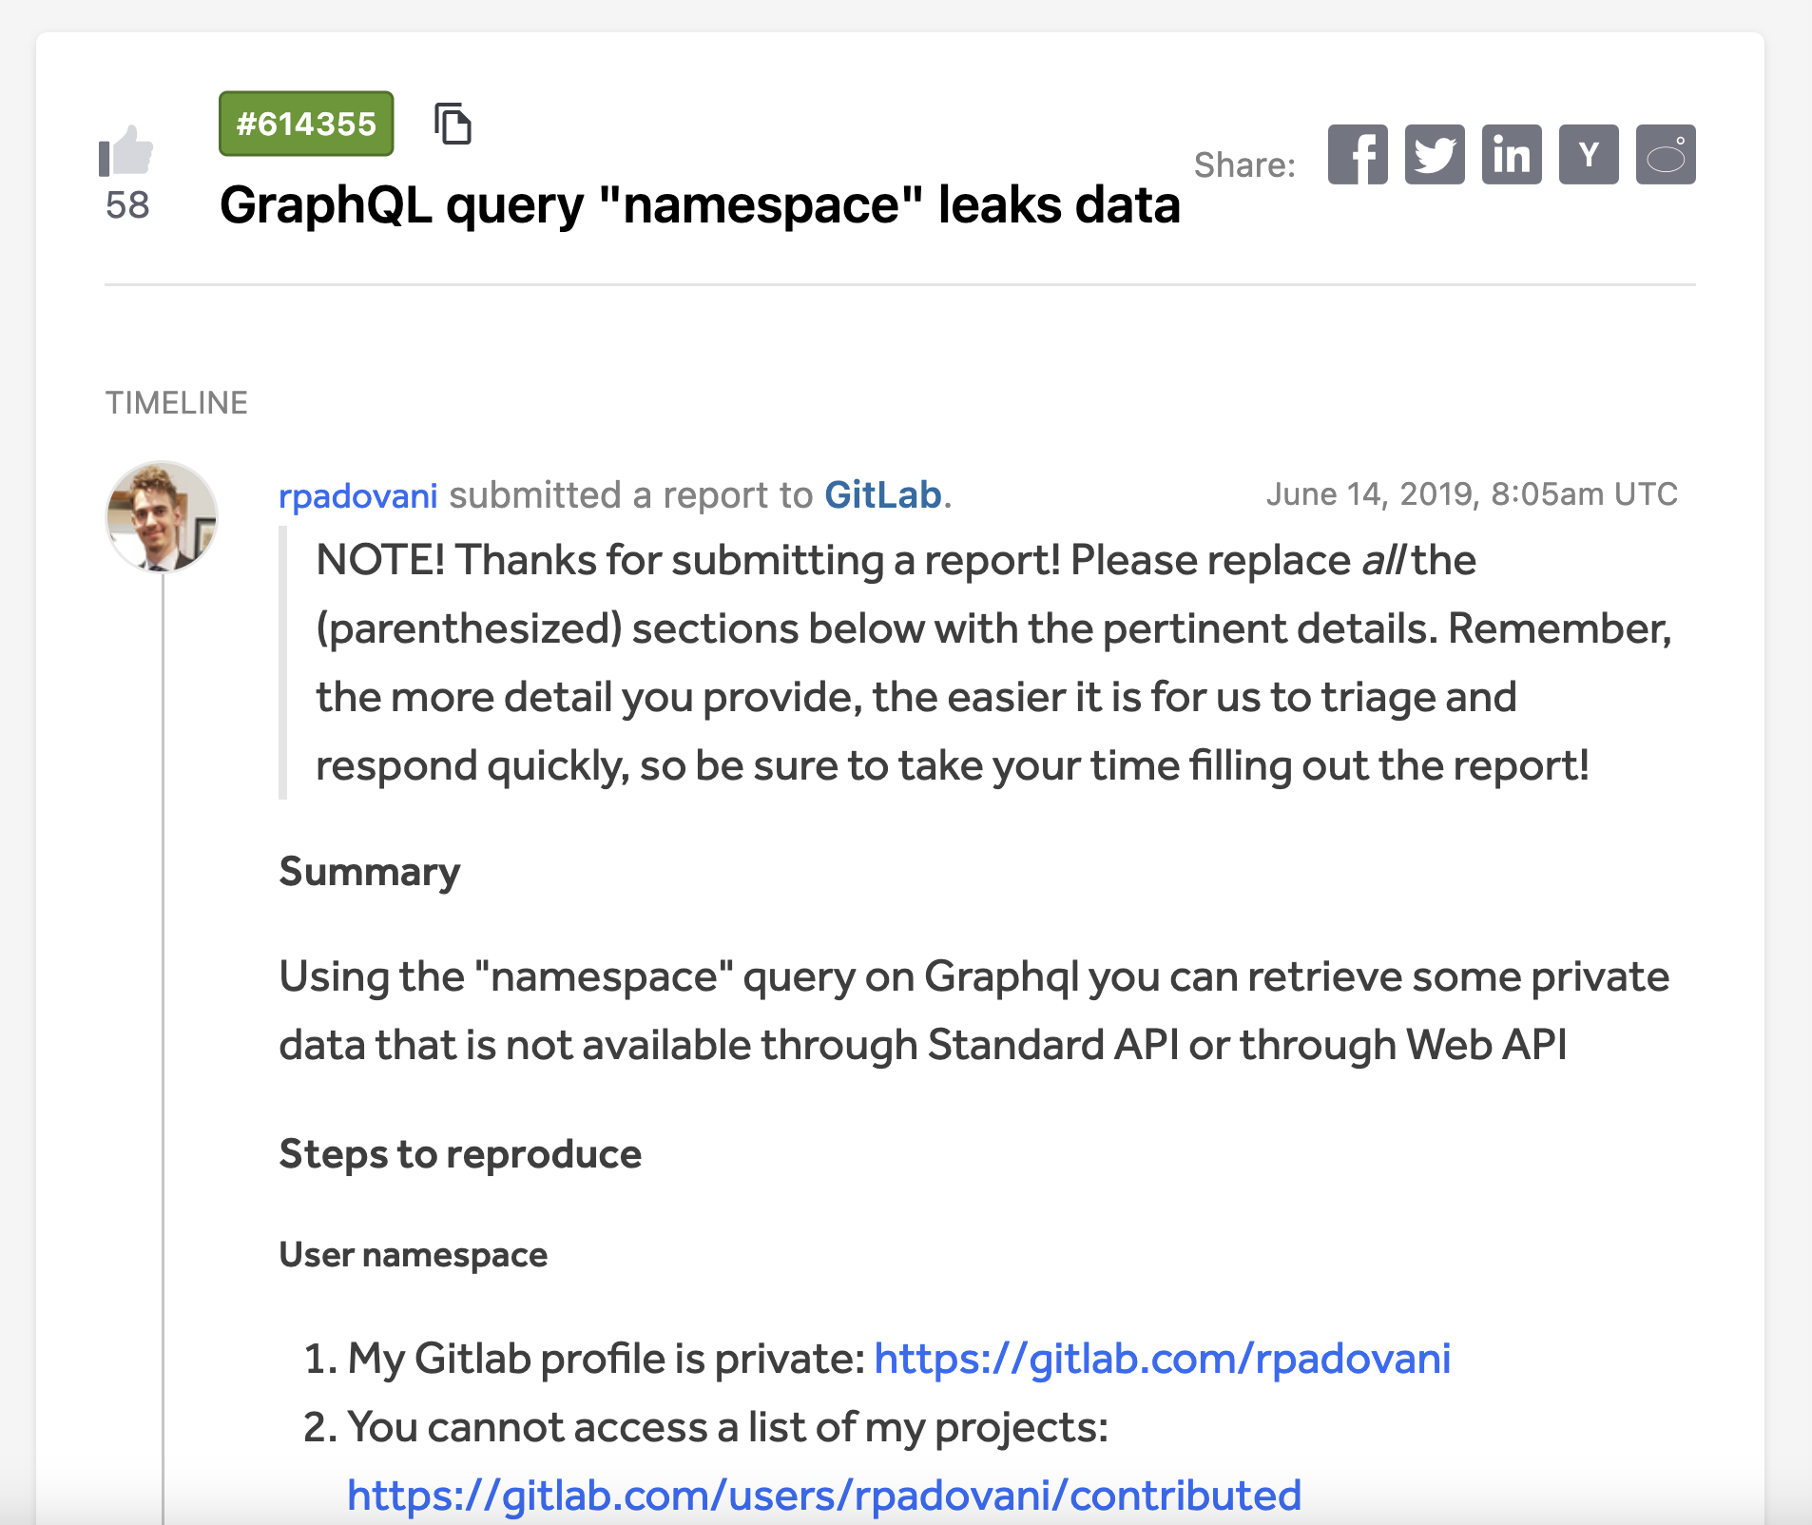
(GitLab) Unintended GraphQL query
GitLab had a GraphQL query that can did not check access permissions of the authenticated user for “namespace” list query.
An attacker can retrieve out other members private data.

Slide 42
IDOR Detection on GraphQL

Slide 43
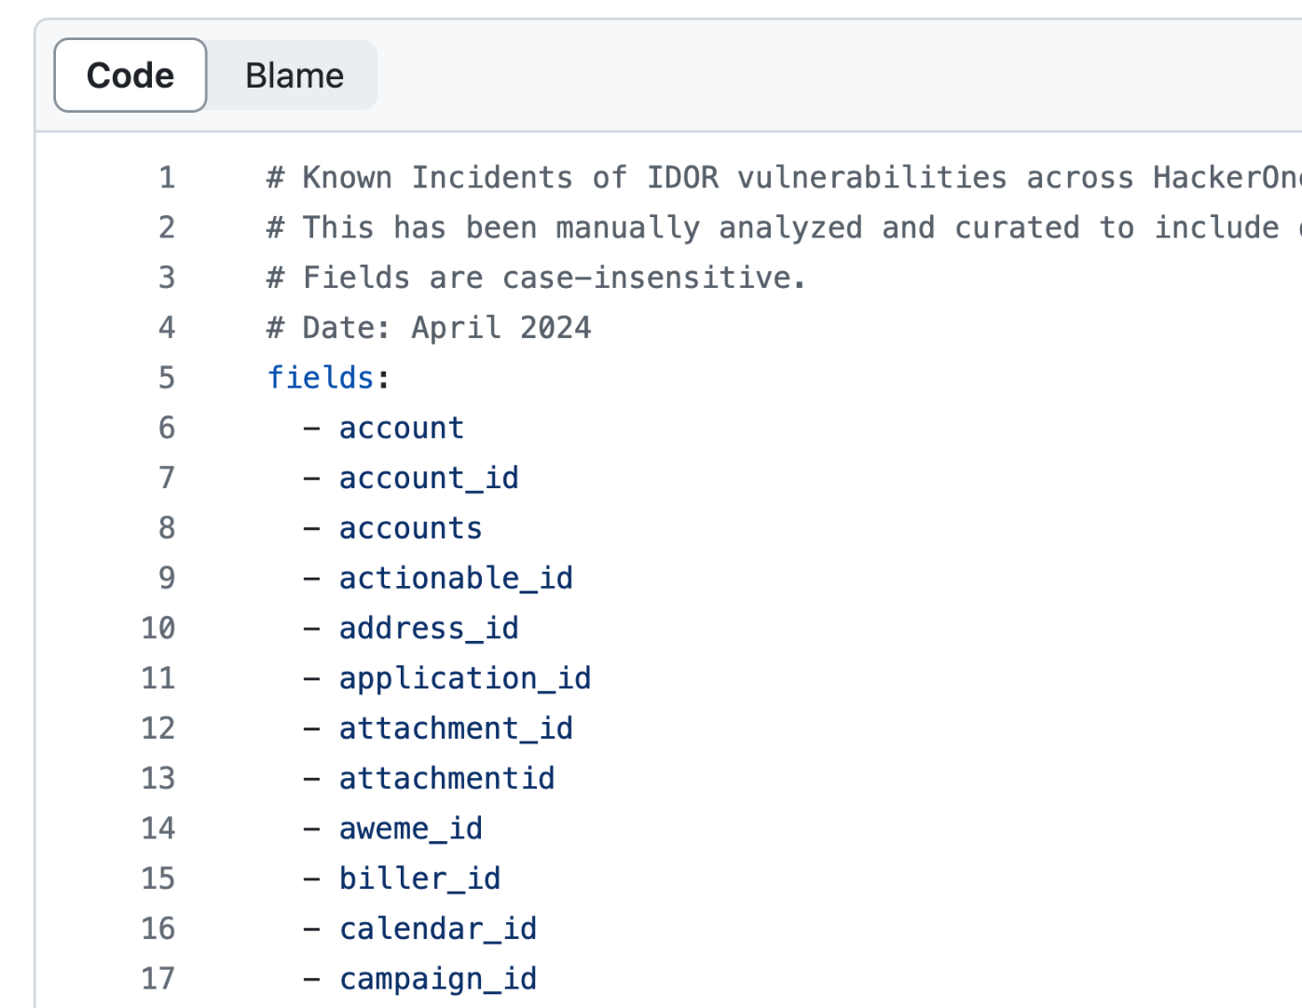

IDOR Detection on GraphQL
I analyzed hundreds of public vulnerability reports to learn about patterns in IDOR vulnerabilities.
I built a ruleset of IDOR fields that has have been seen in previous public incidents.
This is now used in security tooling for annotating potential IDOR fields for security scanning.
Download ruleset
3RsoEKk

Slide 44
PII Detection on GraphQL

Slide 45
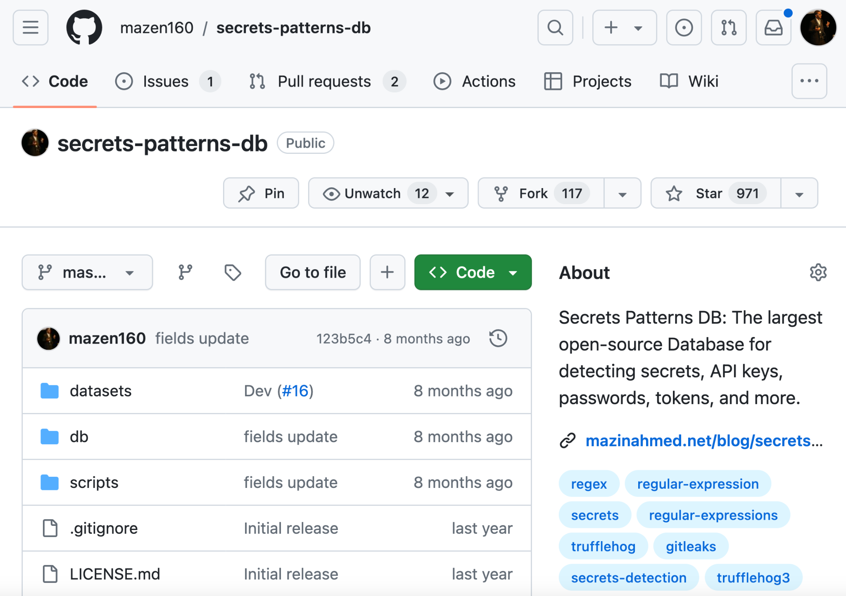
PII Detection on GraphQL
I have curated thousands of sources for secrets, API keys, sensitive data, PII data, and PII fields.
It’s a generic ruleset for all sorts of tooling and projects.
I use it for security tooling to annotate GraphQL PII fields for review.

Slide 46
{{ Defenes }}

Slide 47
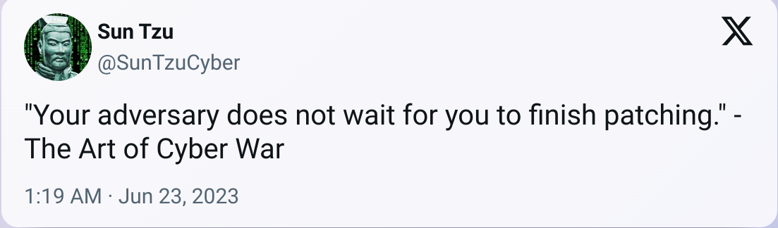
Defenses

Slide 48
Defenses
Service-level rate limiting: The golden rule, Rate Limiting defense should be on the service-level, not on the API level to avoid bypasses.
Query Timeout: You can set a timeout on GraphQL queries.
  This needs to be tested properly, as internal calls may have been already initiated and will not be cancelled if the upstream API timed out.
Disable Batching:
  This doesn’t mean that other variants can’t be abused.
Query cost analysis:
  Can be harder to implement, but it’s still a good defense layer.
Maximum depth limits: This can prevent complex queries executions.

Slide 49
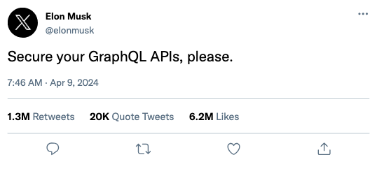
Defenses

Slide 50
Defenses
NOT REAL :)
I wish it was

Slide 51
Final Thoughts
GraphQL is extremely powerful.
As security engineers, our job is to empower teams to run projects and adapt better technologies.
GraphQL needs a lot more attention across organizations.

Slide 52
Questions?
Mazin Ahmed
mazin@mazinahmed.net
Twitter: @mazen160

Slide 53
Thank you!
Mazin Ahmed
mazin@mazinahmed.net
Twitter: @mazen160

